Slide 1
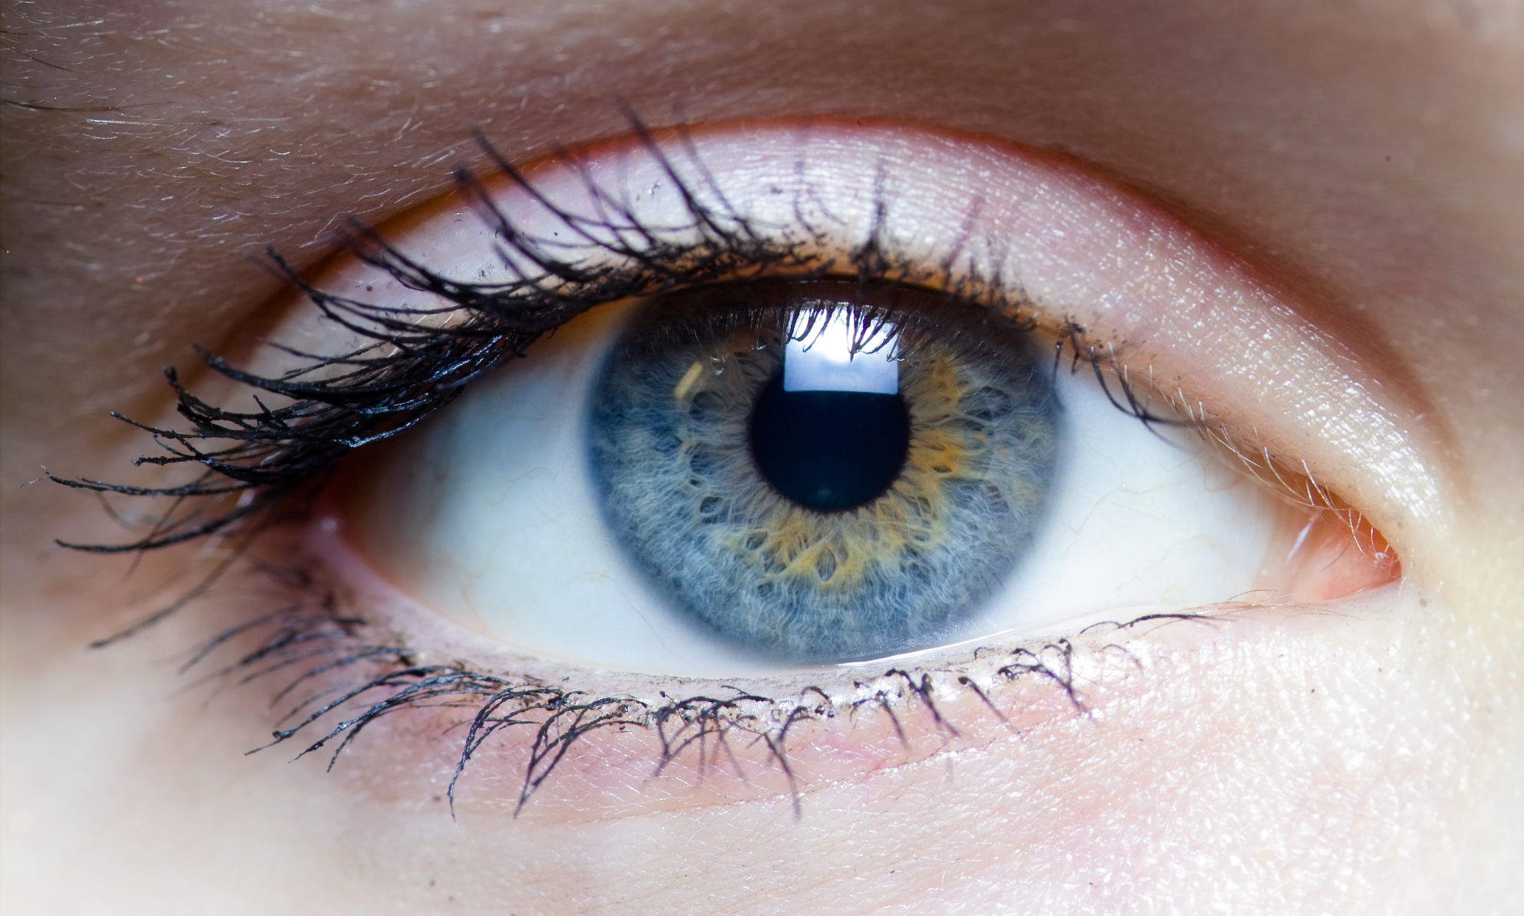
OBSERVATION & INFERENCE
We will compare observation and inference using examples
Notes:
Insert cover image and use transparency settings to fade image.

Slide 2
Do not delete this slide.
This slide is designed so that you can copy the prompt box you need and insert it into your slides.
This slide is hidden and will not be included when presenting your lesson.
TRACK WITH ME
VOCABULARY
1 -
HINT
Students, remember….
CHECK FOR UNDERSTANDING
READ WITH ME
TEACHER CUE
MAKE THE CONNECTION
Students, you already know….
EXTENSION

Slide 3
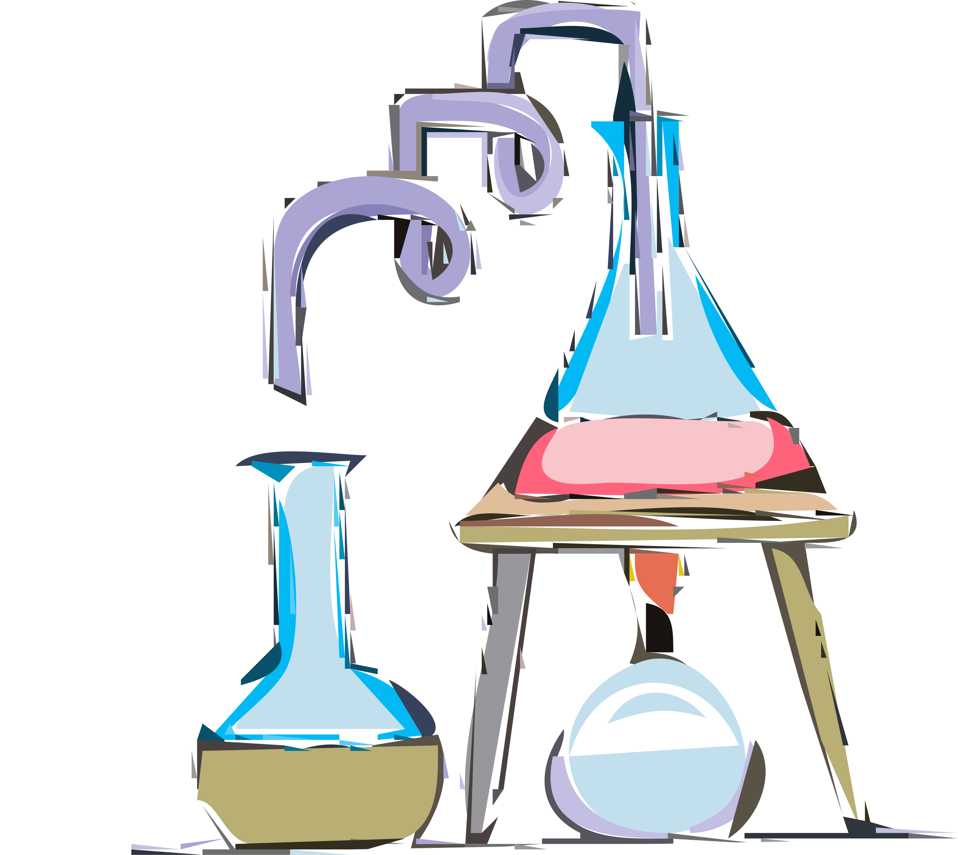
Sort the safety rules into either DO or DO NOT using the the table below:
eat in the laboratory
bring bags into the laboratory
follow instructions
tie back long hair
sit on benches
DO | DO NOT

Slide 4
Repeat the opposite word/phrase.
LABORATORY
ROOM FOR SCIENCE

Slide 5
Repeat the opposite word/phrase.
SUMMARISE
WRITE THE MAIN IDEAS

Slide 6
Repeat the opposite word/phrase.
DEMONSTRATE
SHOW WITH ACTION

Slide 7
Repeat the opposite word/phrase.
NORM
WAY OF DOING THINGS

Slide 8
Repeat the opposite word/phrase.
SCIENTIFIC
TO DO WITH SCIENCE

Slide 9
We will compare₁ observations and inferences
TRACK WITH ME
READ WITH ME
We will define observation
We will define inference
We will list observations and inferences using examples
DECLARE THE OBJECTIVE
Read the learning objective to your partner.
VOCABULARY
1 - Look at the differences
Notes:
Learning Objectives contain concepts (nouns, big ideas), skills (verbs, measurable behaviours) and sometimes context (restricting or targeting conditions).
●Example: Students will be able to describe the concept of density and apply it to floating and sinking.
●
Success criteria are specific measurable outcomes that if met mean that the student has met the learning objective.
Examples:
•Students will be able to compare densities of substances using mass and volume.
•Students will be able to identify whether a solid or liquid will float or sink in a liquid based on their densities.

Slide 10
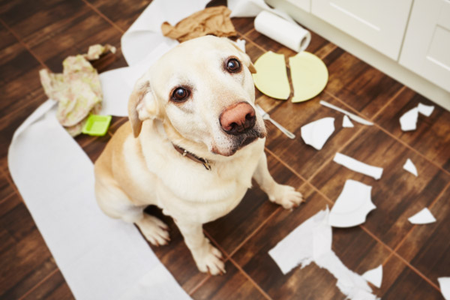
We will compare observations and inferences
End
1
2
3
4
5
6
7
8
9
10
11
12
13
14
15
16
17
18
19
20
21
22
23
24
25
26
27
28
29
30
What do you observe in the picture. Be as descriptive as you can!
TEACHER CUE
Sentence starters: I see…. I smell…. I taste….

Slide 11
We will compare observations and inferences
Is “A naughty dog that has made a mess” an observation or something you have observed?
TEACHER CUE
What is an observation?

Slide 12
We will compare observations and inferences
Observations are pieces of information that we get directly from our senses- sight, hearing, touch, smell and taste.
Is “A naughty dog that has made a mess” an observation?
No- it is what you think has happened based ono what you see.
This is called an inference.

Slide 13
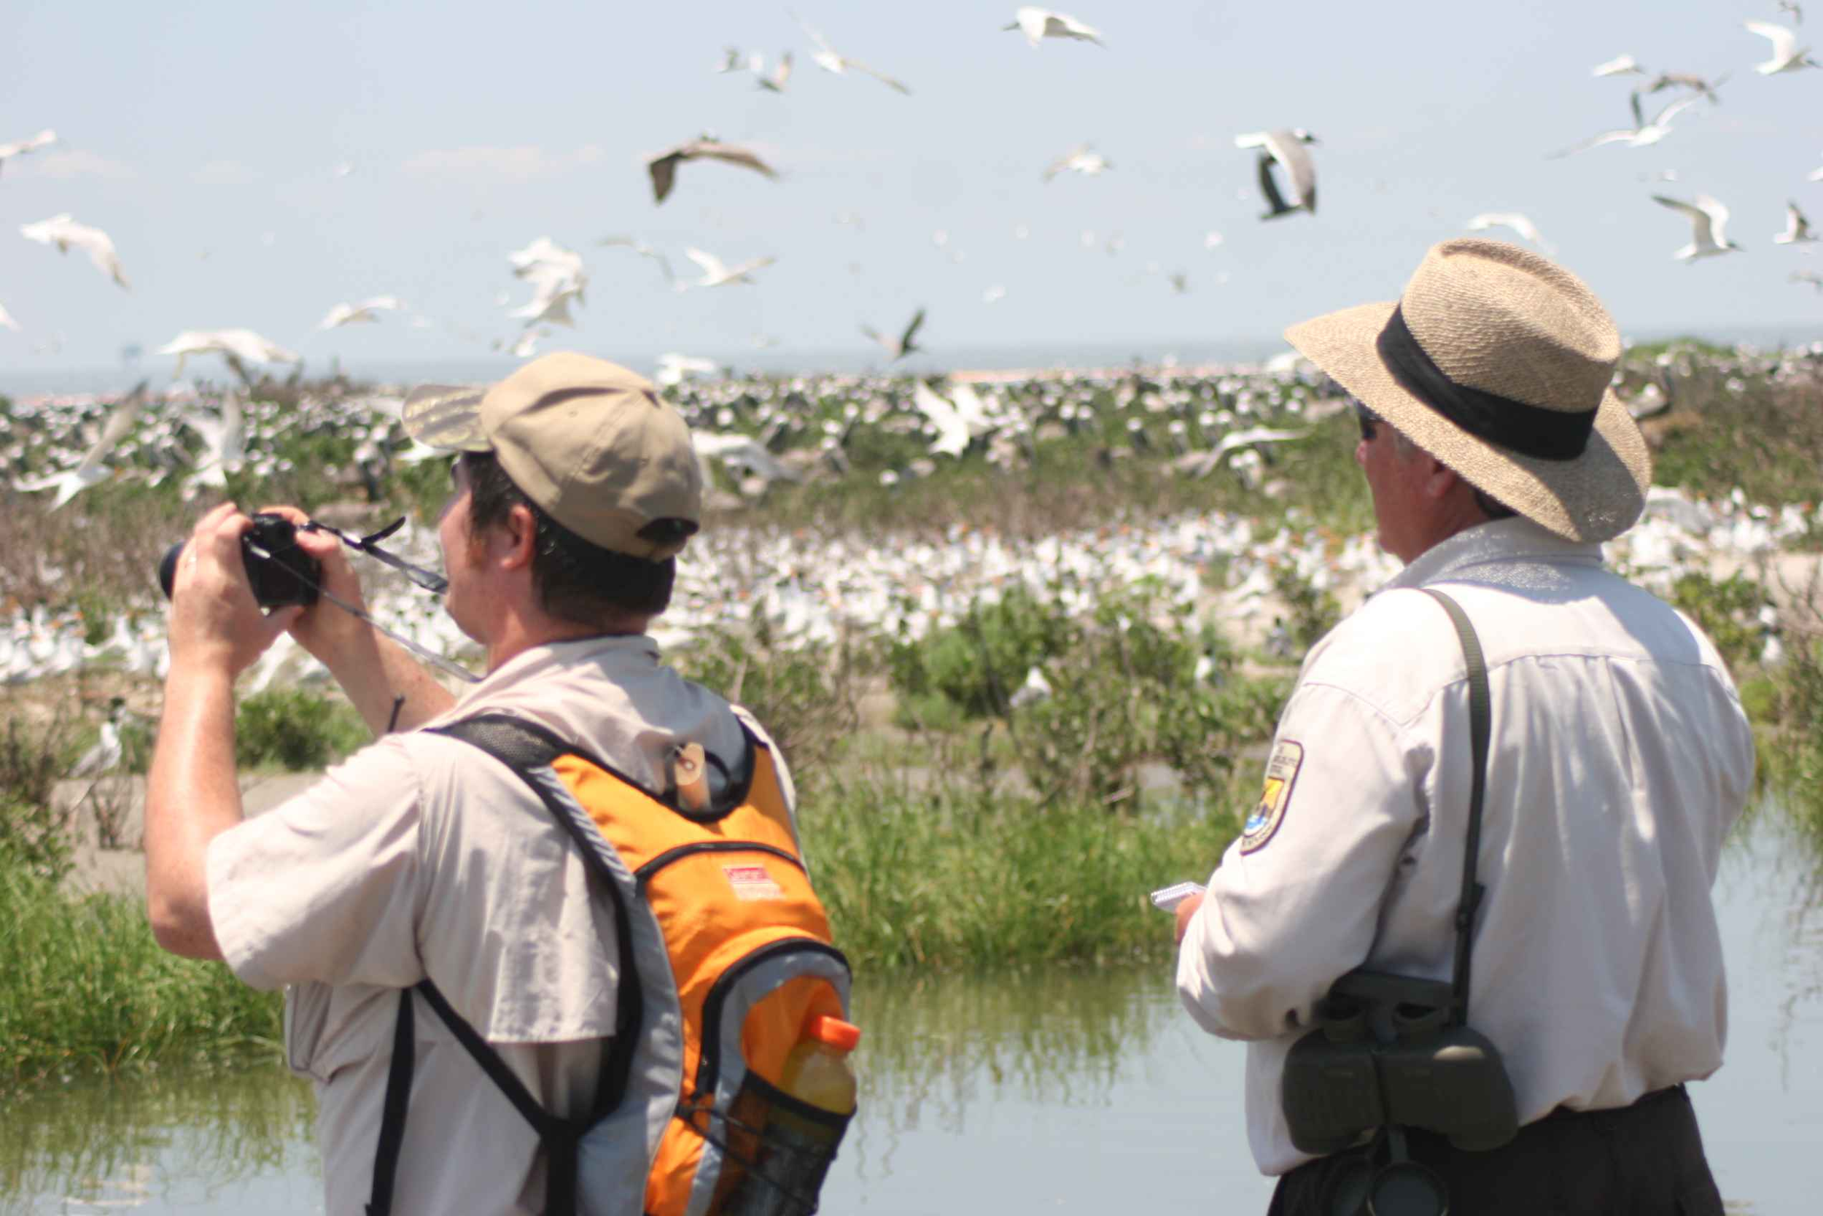
We will compare observations and inferences
CHECK FOR UNDERSTANDING
Look at the image. What would be some observations and inferences by one of the scientists? Pair-Share
Observations provide scientists with information during experiments.
Changes of colour, warmth and light are observations we make all the time in experiments.
Inferences help us know what to make of the observations we make as scientists!

Slide 14
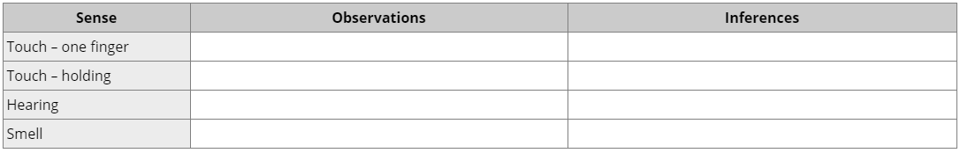
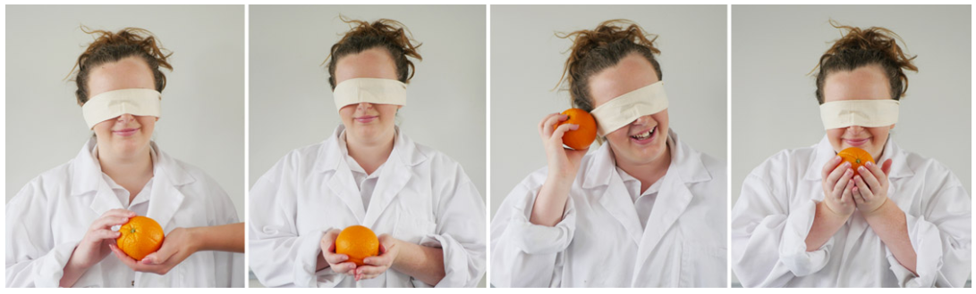
We will compare observations and inferences
Activity time!
For this activity, one member of your group will be blindfolded and will observe an object without looking at it. You will fill out the table with your group members observations and inferences.
Notes:
1. Hold the object for the blindfolded group member to touch with one finger. You may need to guide their hand.
2. Place the object in their hands.
3. Ask them to listen to the object. Does it make a sound? What if they shake it gently?
4. Ask them to smell the object.

Slide 15
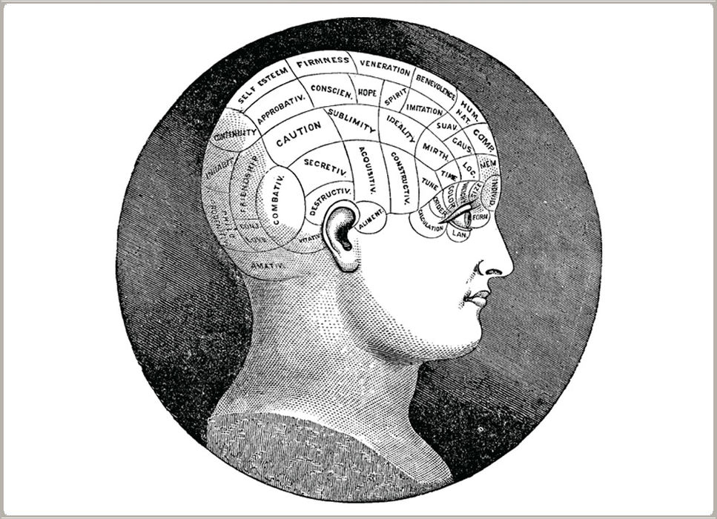
We will compare observations and inferences
Inferences aren’t always correct…
In the 19th century there were scientists called phrenologists who spent a lot of time measuring people's heads. They had a theory that the size and shape of someone's skull was evidence of their personality and intelligence.
This theory was an inference based on two pieces of knowledge:
the brain is responsible for thought and behaviour, and
the brain is made up of different parts.
Notes:
1. Hold the object for the blindfolded group member to touch with one finger. You may need to guide their hand.
2. Place the object in their hands.
3. Ask them to listen to the object. Does it make a sound? What if they shake it gently?
4. Ask them to smell the object.

Slide 16
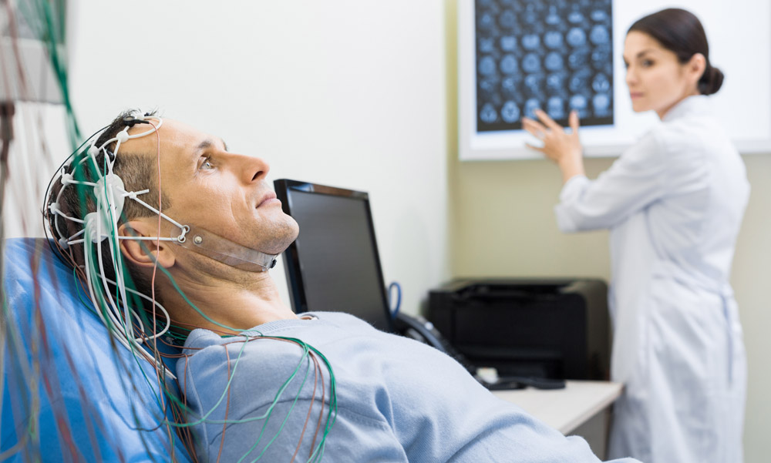
We will compare observations and inferences
Inferences aren’t always correct…
Since then, scientific advances in psychology and neuroscience have allowed us to more accurately map the brain and test its functions.
Scientists have shown that personality and intelligence can be linked to certain parts of the brain, but not to the size and shape of the skull. Phrenology was abandoned by scientists because the new evidence gave us a better explanation.
Notes:
1. Hold the object for the blindfolded group member to touch with one finger. You may need to guide their hand.
2. Place the object in their hands.
3. Ask them to listen to the object. Does it make a sound? What if they shake it gently?
4. Ask them to smell the object.

Slide 17
We will compare observations and inferences
Class discussion:
Describe how well your blindfolded group member able to make observations with their other senses. Explain your answer.
Were they able to figure out what the object was? Describe how their inferences changed as they gained more evidence.
Notes:
1. Hold the object for the blindfolded group member to touch with one finger. You may need to guide their hand.
2. Place the object in their hands.
3. Ask them to listen to the object. Does it make a sound? What if they shake it gently?
4. Ask them to smell the object.

Slide 18
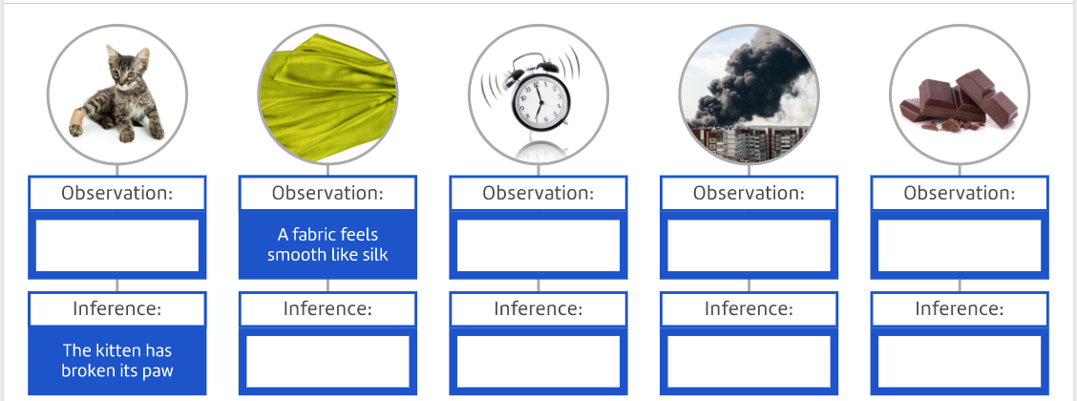

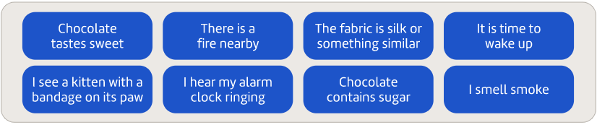
3 minutes
We will compare observations and inferences
Fill in the observations and inferences to complete the chart.

Slide 19
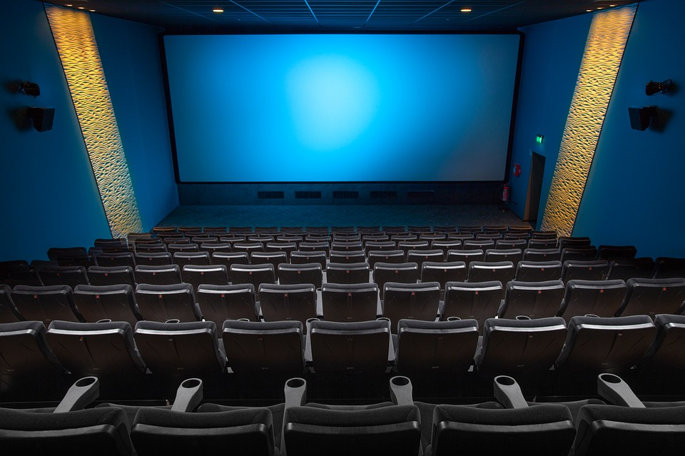
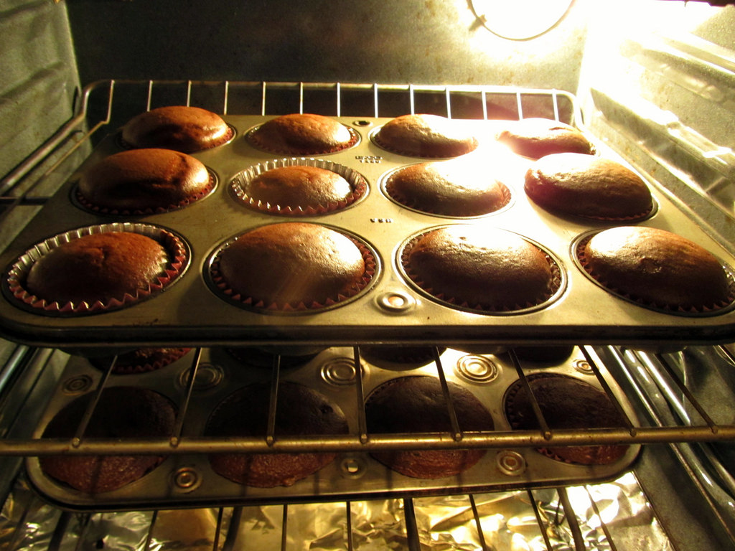
We will compare observations and inferences
5 minutes
Write your own definition of observation and inference.
2. Answer the questions for each picture below.
a) What are your observations?
b) What are your inferences?
A B
Notes:
Please include tasks/questions here rather than just referring to a worksheet. This will save on photocopying and facilitate sharing with other schools.
Try and build tasks/questions which escalate through Bloom’s Taxonomy. This will help with differentiation.

Slide 20
We will compare₁ observation and inference using examples
We will define observation
We will define inference
We will list observations and inferences using examples
CHECK FOR UNDERSTANDING
Check Success Criteria.
VOCABULARY
1 - Look at the differences
Notes:
Learning Objectives contain concepts (nouns, big ideas), skills (verbs, measurable behaviours) and sometimes context (restricting or targeting conditions).
●Example: Students will be able to describe the concept of density and apply it to floating and sinking.
●
Success criteria are specific measurable outcomes that if met mean that the student has met the learning objective.
Examples:
•Students will be able to compare densities of substances using mass and volume.
•Students will be able to identify whether a solid or liquid will float or sink in a liquid based on their densities.

